Slide 1

Mobile Friendly Bravo Consulting Website
Project overview
Group A

Slide 2
Introduction
Overview of team
ID | Name | Role
30361543 | Ajit Kunwar | Scrum Master/Tester/DB
30361559 | Birendra Rokaha | Product Manager/ Design and Code
30347752 | Sushant Adhikari | Documentation/Tester
30117452 | Chao Zhang | Documentation/Code

Slide 3

Client
Client Name:
Bravo careers / Arif Systems​
Bravo careers are renounced consulting firm in Melbourne with services provided in multiple fields such as employee management, educational, financial and HR consulting services.

Slide 4
Project background
A contemporary web platform with:
Modern Design Language
Modern Layout
Mobile Responsiveness
App like performance
Accessibility

Slide 5
Project Background
Requirements | Conditions of satisfaction | Tasks and estimates | Estimated time
SD1: Web Framework | Creation of web framework for content | T1: Create a web framework T2: List all sections of the website T3: Every member reviews the framework and gives feedback | 10-12 hours
SD2: Modifying the original design prototype for both desktop and mobile view | modify of the initial design prototype using the prototyping software – Figma to incorporate views for both desktop and mobile view | T1: Modifying the theme by following standard design patterns for the website. T2: Creation of Web and Desktop responsive view with prototyping T3: Every member reviews the prototype and provides feedback. | 8-9 hours
SD3: Debugging/Testing and implementing prototype to Web framework | Implementing the prototype into actual HTML framework and testing | T1: Implement the prototype and Create index page for the website using web technologies. T2: The testers will conduct debugging and documentation. | 5-8 hours

Slide 6
Project background
Especially focused on the mobile first design philosophy and layout. The business implementation is that potential clients can engage directly with the consultants and the consultants can manage a better client relationship.
Responsive design- It is a new website design concept in which a website scales/transforms form desktop, tablet and mobile interface by using only one codebase.

Slide 7
Methodology
Our project follows an Agile software development process as stated by the course description
Scrum/Kanban are used to visualize our story board for clear progress communication.
Git is used as source and version controlled and GitHub is used as the repository.
Design/framework is kept minimal and flexible to incorporate for further client requests,

Slide 8
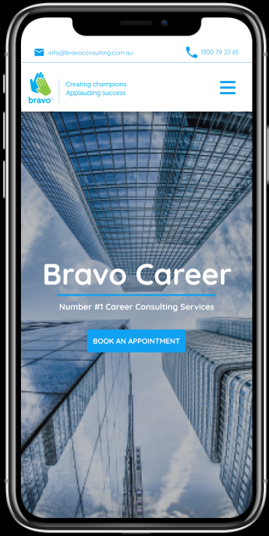
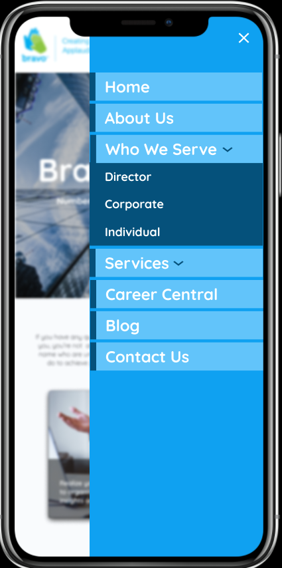
Demonstration
Design layout is ready and set up. - interface, Manu
Fully functioning prototype live through Figma online.
Backend code has started.

Slide 9
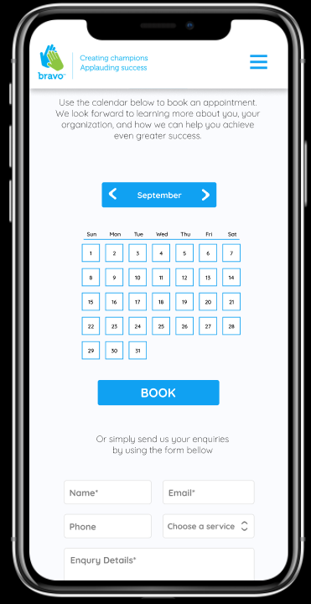
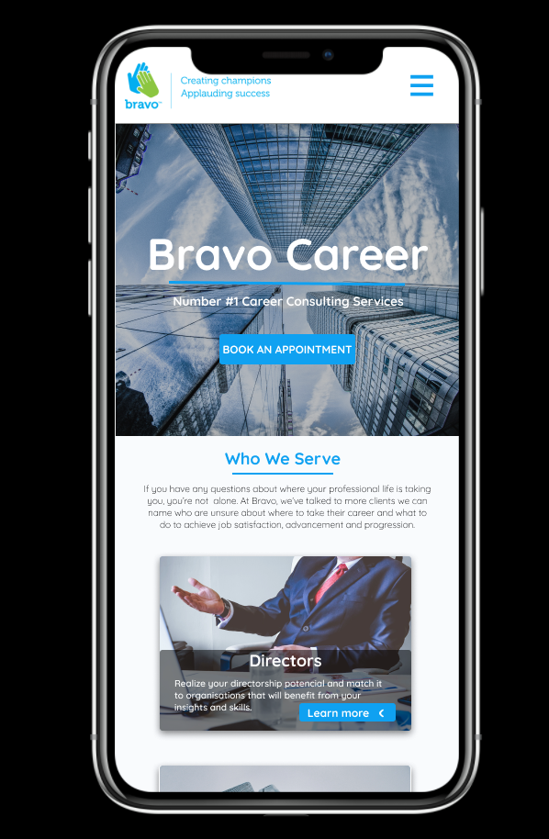
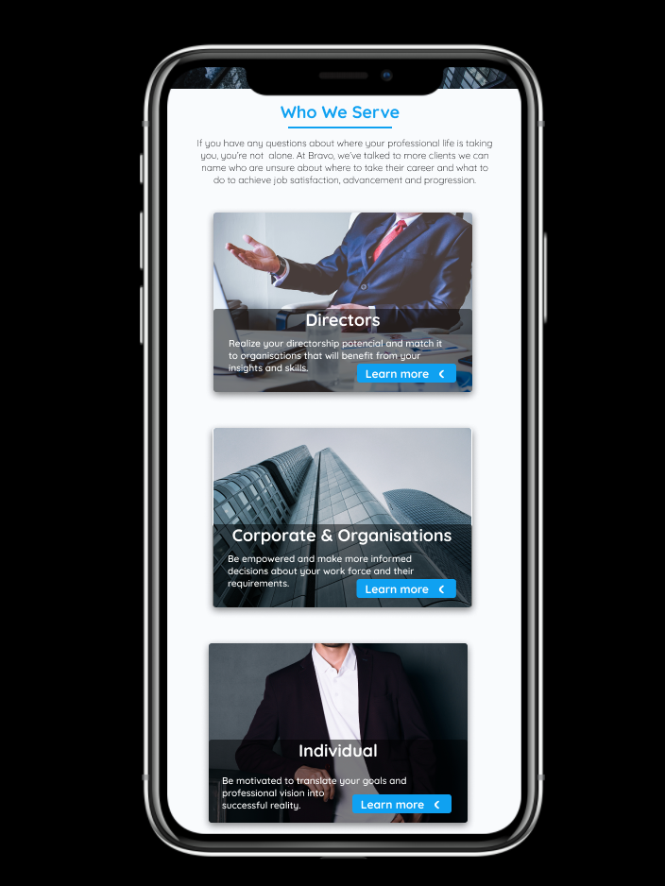
Demonstration
Here are more samples
The Calendar system has been added as client required.

Slide 10
Demonstration
Tools and Technologies:
Design and prototype: Figma
IDE: Visual studio code for frontend and Backend coding
Front end technologies: This is the code that runs on client’s device and contains layout and interface. HTML5, CSS3, SASS, Bootstrap and Vanilla JavaScript
Back end technologies: This is the code that runs on the servers and contain all the business logic. MERN stack: MongoDB(database), Express, React and NodeJS
Debugging and testing: Chrome Developer Tools and Firefox Developer Tools
Git Repository: GitHub
Team collaboration: Microsoft teams, Messenger, Trello and Skype
Documentation storage and sharing: Google Drive, Google Docs and Gmail

Slide 11
Potential features
Chatbot: Our team is looking to implement a chatbot that will automatically guide users to their desired services. However, it is very vast task, difficult to implement and not required by the client, so as of today it is still only in initial analyzation phase.
24/7 support: A support chat service so clients can connect easily with their respective consultants

Slide 12
Feedback
Client Feedback
Design is nice and clear.
Make the navigation in each page.​
Add calendar system. (prefer a new one)
Add Appointment service.
Required online Ads system.

Slide 13
Feedback
Discussion
Interface improvement.
Make the navigation in each page.​
​Add one Ads dashboard.
Improve the calendar system.
Add Appointment service and joint with calendar system.

Slide 14
Critical reflection
Things went right
Each member conducted further reading in their appointed domains.
We looked at various industry trends to gather more requirements and tweak our designs further.
We also worked on some client feedback from the first project to add additional features into the website design and change few layout patterns.
Got some experimental ideas that we may try to implement.

Slide 15
Critical reflection
Things Need to be Improved
Members should maintain more communication. Keep updating for every change of the project.
Arrange more meeting with client if possible, to meet client’s requirement.
Developing necessary skills, e.g. coding, framework.
Run few more test before showing work to client.

Slide 16
conclusion
We have nearly met all the requirement from our client. Few more improvement and further development need to be done to our initial design prototype.
The team is well set up and every member is focused on what to do next.
The storyboard is clear and we are ready to start our next sprint in which we are implementing a local server and adding content to our web framework.

Slide 17

Thank you for your attention! Any Questions??

